Slide 1

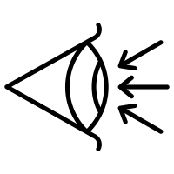
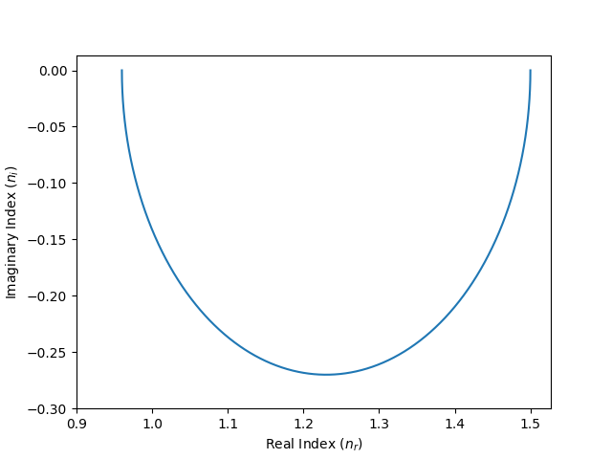
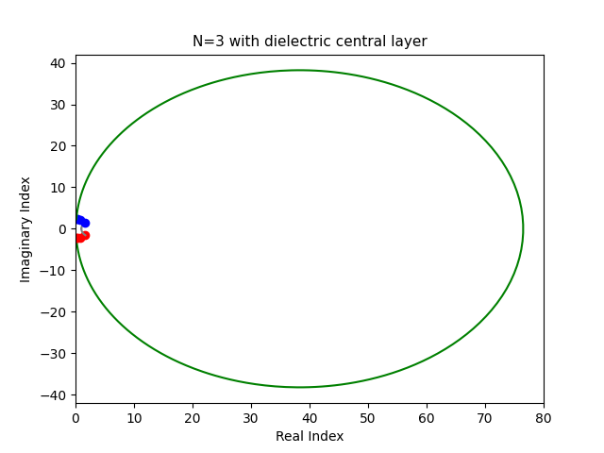
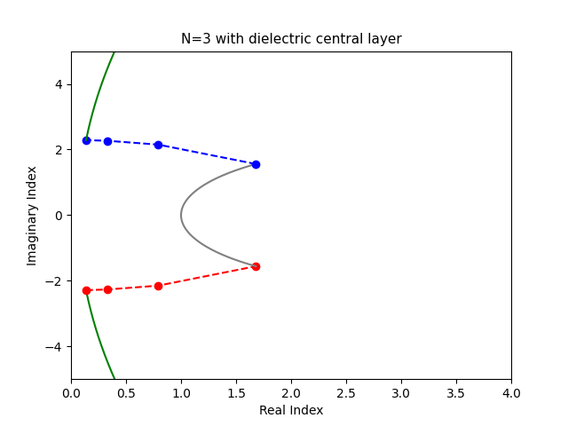
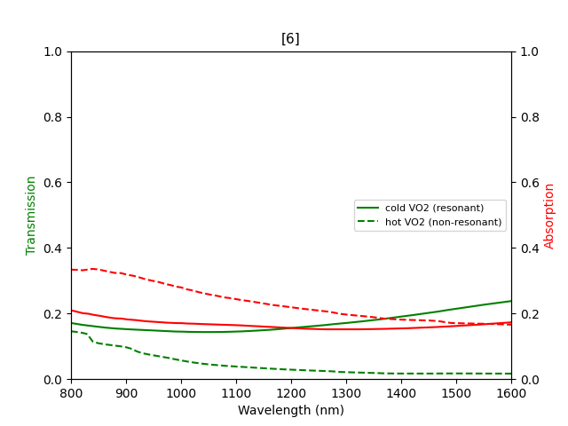
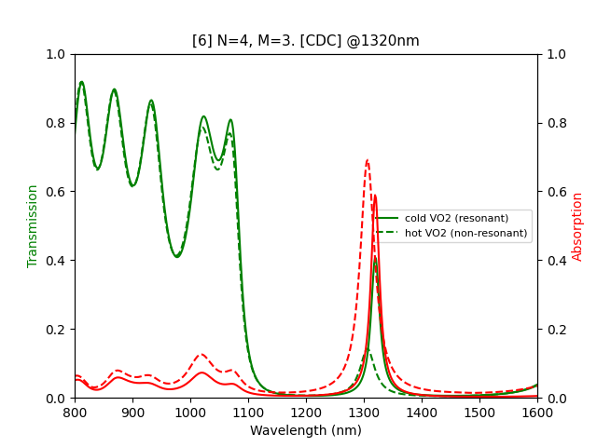
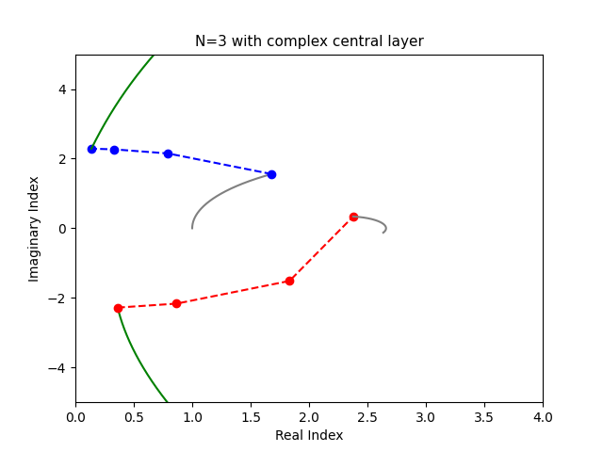
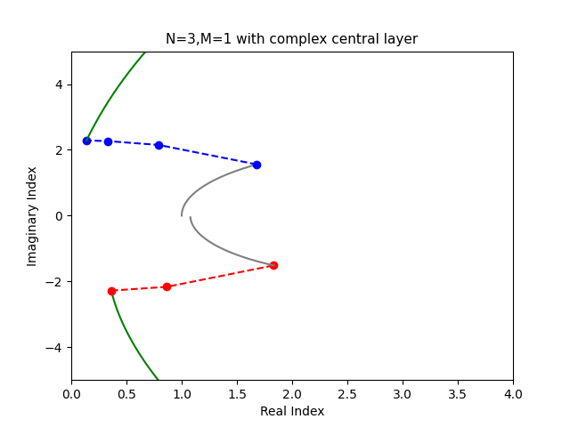

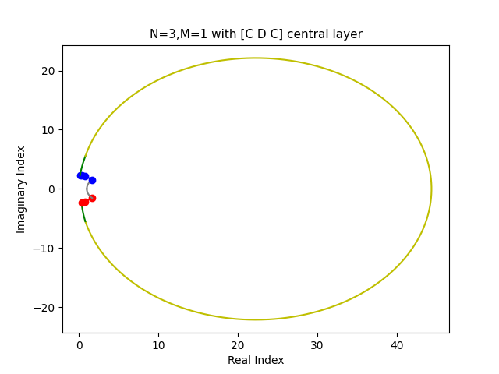







AsymReca
Optical limiter design using 10x less VO₂
Asymmetrical resonant cavity thin-film devices designed for VO₂ applications
Keywords: optical thin film, thin film design, vanadium dioxide
Chettanat Padungatthakij¹, Surawut Wicharn², and Prathan Buranasiri^{1*}
¹Department of Physics, King Mongkut’s Institute of Technology Ladkrabang, ²Advanced Photonic Laboratory, Department of Physics, Faculty of Science, Srinakharinwirot University
*(prathan.bu@kmitl.ac.th)
Optical Limiter
- Protect human eyes, sensor and laser head.
- Self-activated with high-intensity light.
1. Introduction
- PCMs change their crystal structure above T_{trans}. This greatly alter their n, k index.
- We can use this property to design an optical limiter, optical diode, smart window, optical filter, etc.
- VO₂ is a volatile PCM with lowest T_{trans}=68°C. It exhibits large mode contrast in the IR spectrum.
- Resonant cavity allows light to cycle the central layer multiple time. Enhance its optical properties while allowing for thinner central layer.
- Resonant cavity can’t be create with PCMs because of their high k index.
- Here, we use an asymmetrical resonant cavity design with VO₂ central layer for an optical limiter.
Low power
Phase Change Materials
Transition temperature
on
Vanadium dioxide
Ex: at 1,550 nm n_{30°C}=2.86+0.28j and n_{70°C}=1.61+2.72j.
High power
off
Imaginary refractive index
[10] A. Sarangan, “Design of resonant cavity thin film structures with complex active layers,” J. Opt. Soc. Am. B 37, 3461-3468 (2020).
2. Theory
- Optical thin film theory: Films thickness determines whether the device exhibits AR or high-reflection property. Normally it’s either QWOT or HWOT.
- Designing resonant cavity: By placing a central layer between two high-reflection mirror will make light bounce through the central layer multiple time. Amplifying the absorption and transmission.
- AsymReca: By using different #N for each side, we can restore resonance with a central PCM layer.
Quarter-wave optical thickness
antireflection
Half-wave optical thickness
$$L$$
$\frac{H}{2}$ $\frac{H}{2}$
M
N
$\frac{H}{2}$ $\frac{H}{2}$
$$L$$
$\frac{H}{2}$ $\frac{H}{2}$
3. Result
$$L$$
$$C$$
$$L$$
$\frac{H}{2}$ $\frac{H}{2}$
$$L$$
$\frac{H}{2}$ $\frac{H}{2}$
[5] C. Baratto, et al, “Optical Limiting Sensor Based on Multilayer Optimization of Ag/VO2 Phase Change Material,” IEEE Sensors Letters 7(9).
[6] C. Wan, et al, “Limiting Optical Diodes Enabled by the Phase Transition of Vanadium Dioxide,” ACS Phot. 5(7),
Unit cell
[6] Redesign #1
- Antireflection design
- Resonant @1320 nm
- 14x less VO₂ used
4. Conclusion
- Demonstrated an AsymReca design that allows for precise tuning of VO₂’s phase change properties for an efficient optical limiting device.
- Archives similar or better optical performances with significantly reduced Vo₂ thickness needed.
- Overall bulkier devices.
- Narrow operation bandwidth limits this design to coherence light.
- High deposition complexity may limit real-world implementation.
References
[6] C. Wan, et al, “Limiting Optical Diodes Enabled by the Phase Transition of Vanadium Dioxide,” ACS Phot. 5(7), 2688-2692 (2018).
[7] X. Tian, and Z.Y. Li, “An Optically-Triggered Switchable Mid-Infrared Perfect Absorber Based on Phase-Change Material of Vanadium Dioxide,”
[8] D. d. Ceglia, et al, “Tunable Filters for Visible Light Based on Resonant VO2 Planar Thin Films," 22nd ICTON, 1-4 (2020).
[9] E. Strelcov, Y. Lilach, and A. Kolmakov, “Gas Sensor Based on Metal−Insulator Transition in VO2 Nanowire Thermistor,” Nano. Lett. 9(6), 2322-2326 (2009).
[10] A. Sarangan, “Design of resonant cavity thin film structures with complex active layers,” J. Opt. Soc. Am. B 37, 3461-3468 (2020).
[11] M. N. Polyanskiy. “Refractiveindex.info database of optical constants,” Sci. Data 11. 94(2024).
[12] A. Saragan. “Optical Thin Film Design (1st ed.),” CRC Press. (2020).
[1] M. E. A. Warwick, R. Binions, “Advances in thermochromic vanadium dioxide films,” J. Mater. Chem. A 10, 3275-3292 (2014).
[2] Y. Cui, et al, “Thermochromic VO2 for Energy-Efficient Smart Windows,” Joule 2(9), 1707-1746 (2018).
[3] N.R. Mlyuka, G.A. Niklasson, C.G. Granqvist, “Thermochromic multilayer films of VO2 and TiO2 with enhanced transmittance,”
Sol. Energy Mater. Sol. Cells 93(9), 1685-1687 (2009).
[4] M. G. Wood, et al, "Optically-Triggered Optical Limiters for Short-Wavelength Infrared Sensor Protection," 2021 CLEO. 1-2 (2021). https://doi.org/10.1364/CLEO_SI.2021.STh1E.3
[5] C. Baratto, et al, “Optical Limiting Sensor Based on Multilayer Optimization of Ag/VO2 Phase Change Material,” IEEE Sensors Letters 7(9), 1-3 (2023).

Slide 2
AsymReca
Optical limiter design using 10x less VO₂
Introduction
Sb₂Se₃ is a non-volatile phase-change material (PCM) with very low absorption in the IR spectrum [1].
Its crystallization temperature is 186 °C, comparable to GST (180 °C) but is lower than other non-volatile PCMs (GSST and Sb₂S₃) [2].
It has been demonstrated to have high endurance (10⁷ cycles) [2].
In photonics, it’s mainly used as reconfigurable waveguide [3] but can also be used as optical limiter [4].
Asymmetrical design is used to restore resonant in device with imaginary index. [5]
We designed a 1-D thin film device with anti-reflection property for 532 and 1064 nm limiter.
Low power
on
High power
off

Slide 3
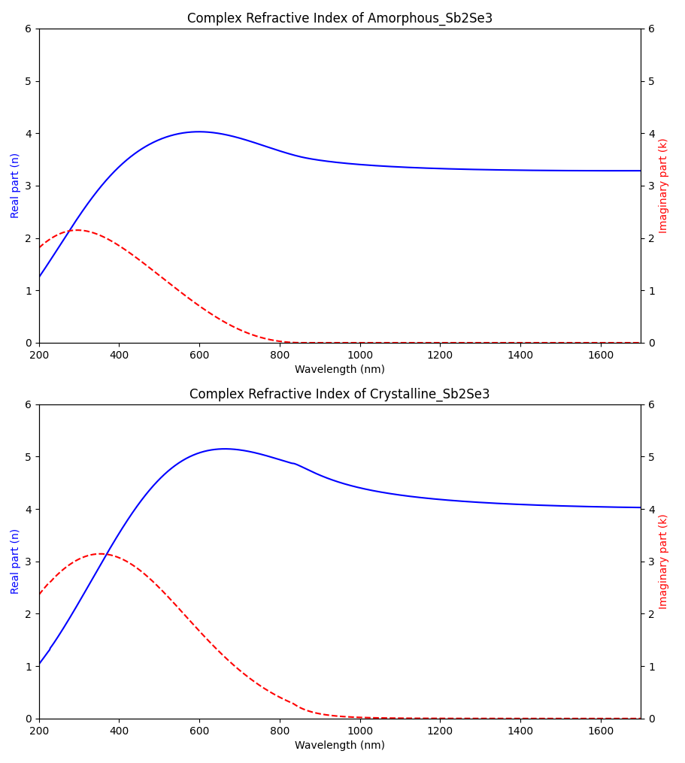
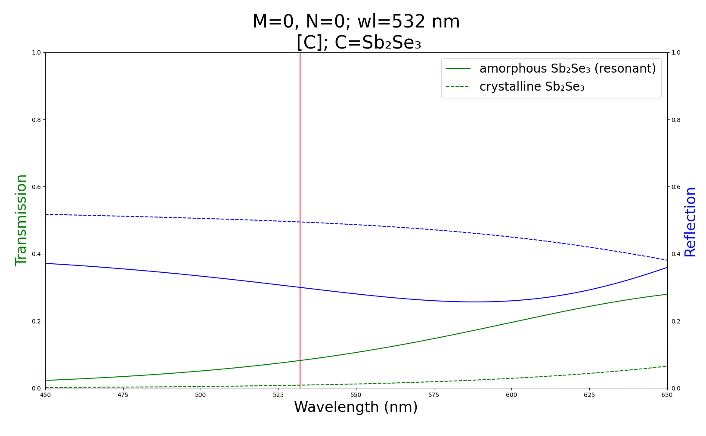
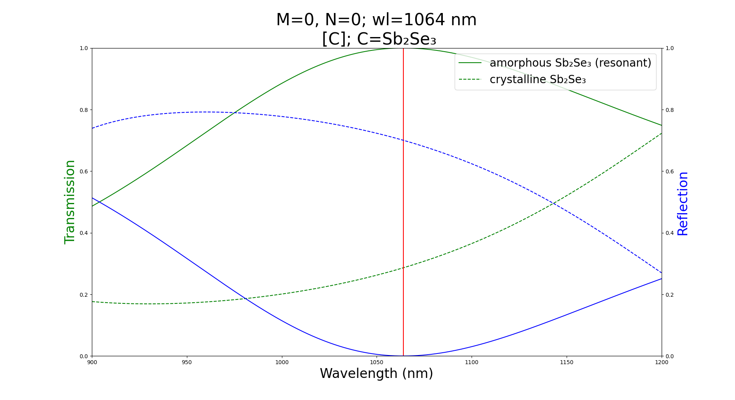
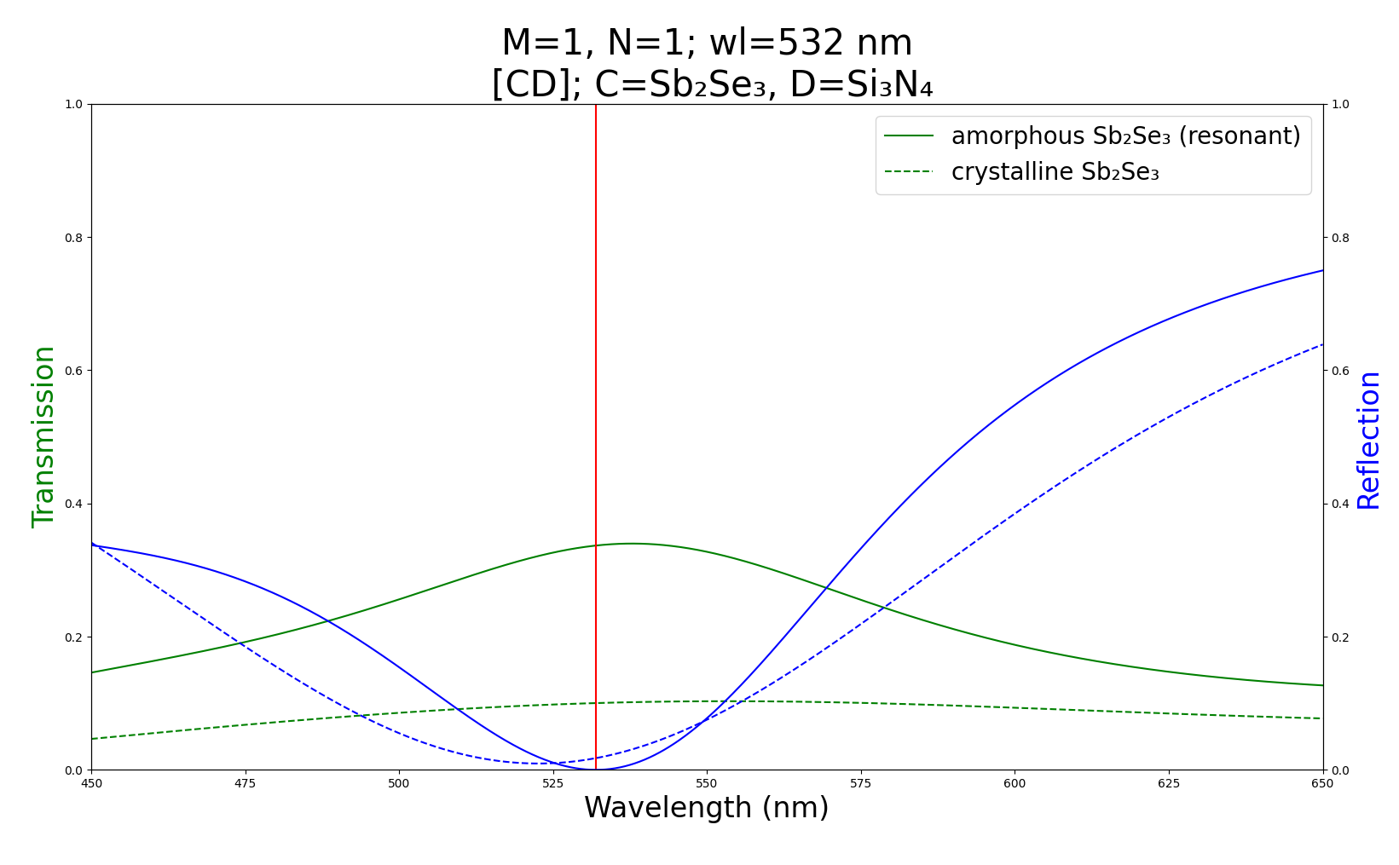
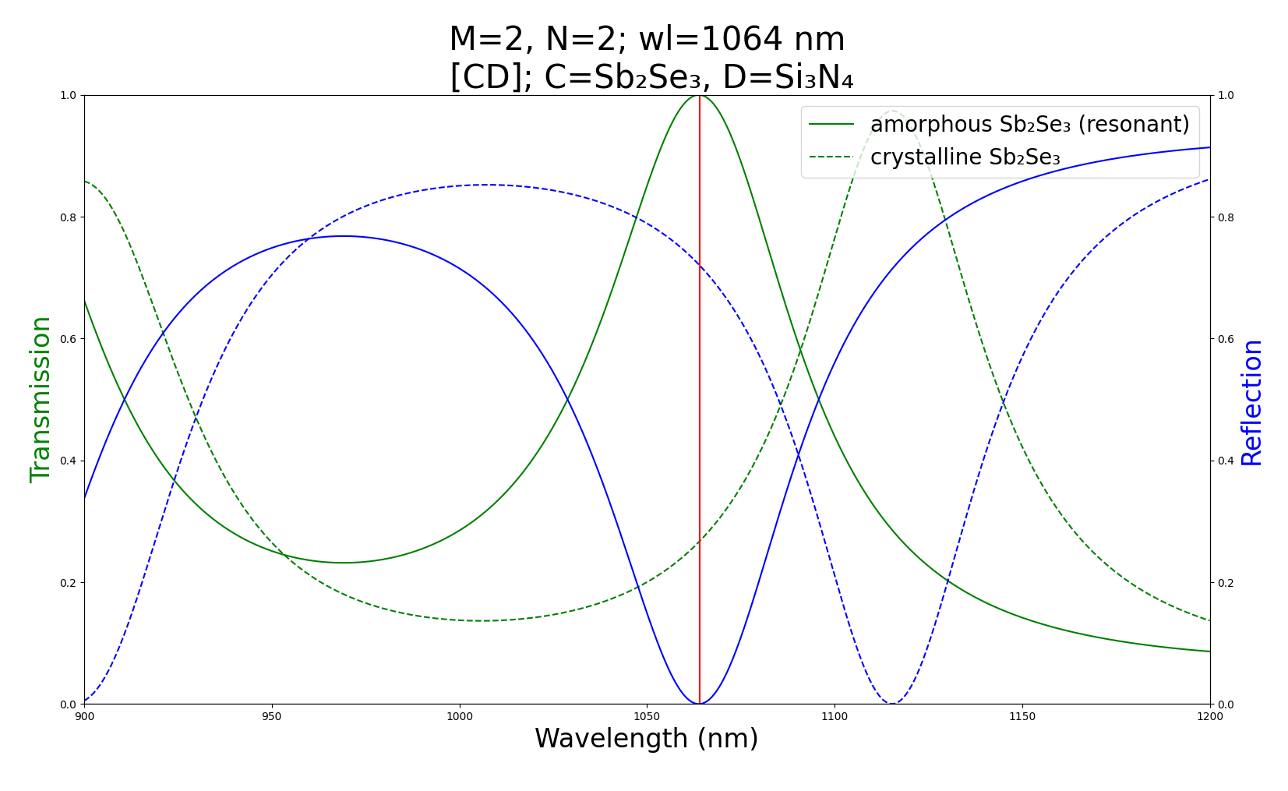
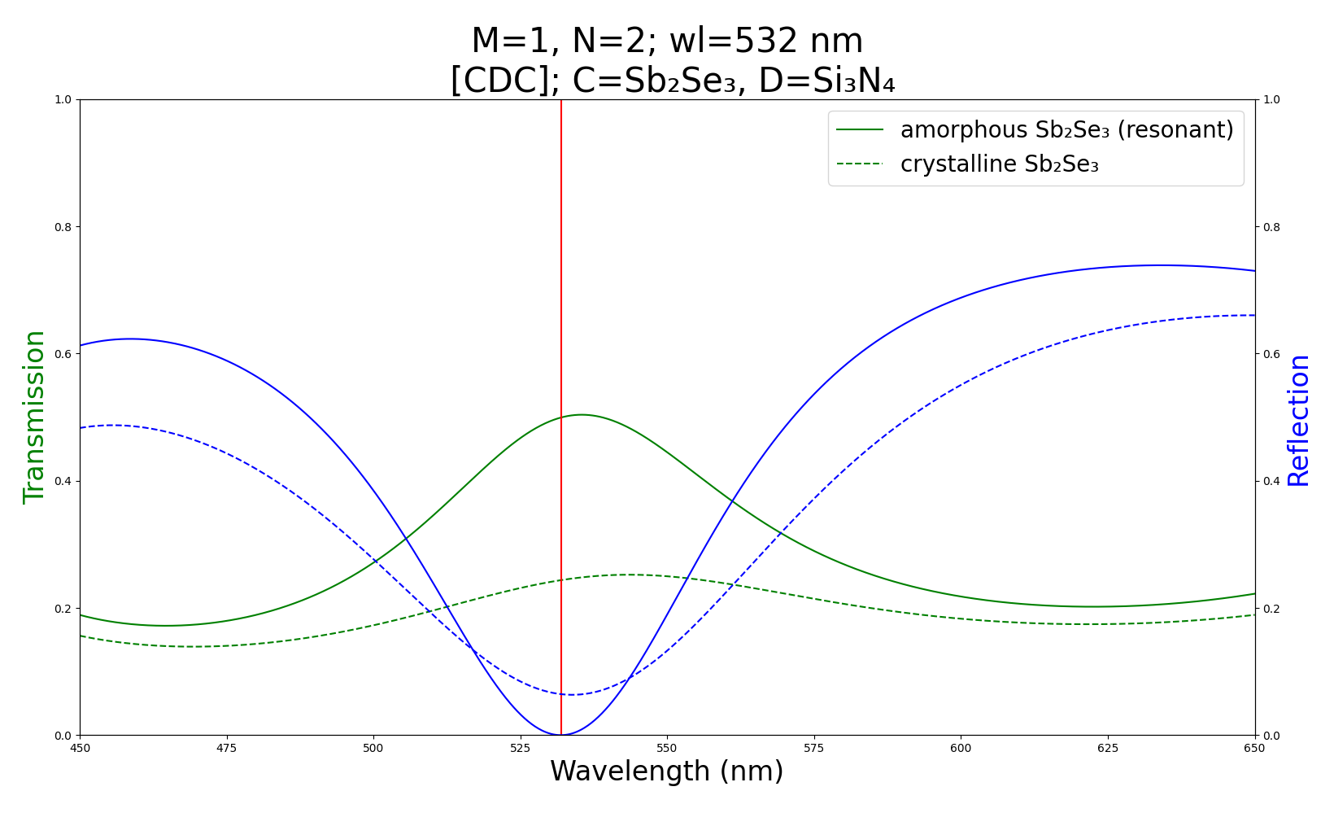
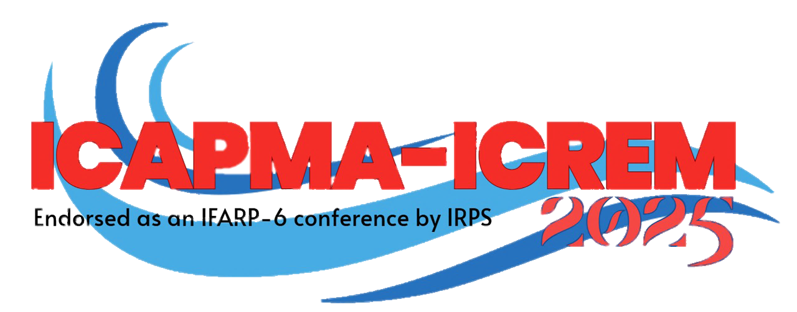



Design and Simulation of Sb₂Se₃-Based Asymmetric Resonant Optical Limiters Using Transfer Matrix Method
Keywords: Optical limiter; Asymmetric resonant cavity; Phase change material
Prathan Buranasiri¹, Chettanat Padungatthakij¹, Suebtarkul Suchat², and Surawut Wicharn^{3*}
1 Department of Physics, School of Science, King Mongkut’s Institute of Technology Ladkrabang;
2 Department of Physics, Faculty of Science and Technology, Phranakhon Rajabhat University;
3 Department of Physics, Faculty of Science, Srinakharinwirot University; * Corresponding author Email: surawutw@g.swu.ac.th
1. Introduction
Sb₂Se₃ is a non-volatile phase change material (PCM) with very low absorption in the IR spectrum^{[1]}. Its crystallization temperature is 186°C, comparable to GST (180 °C), but is lower than other non-volatile PCMs such as GSST or Sb₂S₃^{[2]}. Sb₂Se₃ has been demonstrated to have high phase transition endurance in the order of 10⁷ cycles ^{[2]}. These properties make it attractive as a reconfigurable waveguide^{[3]}. But its usage in another photonic device, optical limiter, hasn’t been explored much ^{[4]}.
Here, we proposed an optical limiter design utilizing asymmetrical resonant cavities comprised of Sb₂Se₃ as central layer.
2. Theory
Anti-reflection can be achieved by quarter-wave optical thickness.
Resonant cavity allows light to cycle through the central PCM layer(s) multiple times, increasing the total absorptivity.
We use Asymmetrical resonant cavity with different number of unit cell on each side, it’s possible to restore resonance even with high k index material ^{[5]}.
3. Result
A) 532 nm
B) 1064 nm
Refractive indices of amorphous (top) and crystalline (bottom) Sb₂Se₃. Data is taken from [6].
T: 8% / 1%
R: 30% / 49%
Sb₂Se₃: 67.1 nm
Device: 67.1 nm
T: 100% / 29%
R: 0% / 70%
Sb₂Se₃: 157.9 nm
Device: 157.9 nm
$$H/2$$
$$H/2$$
$$L$$
$$L$$
$$C$$
$$L$$
$$H/2$$
T: 100% / 26%
R: 0% / 72%
Sb₂Se₃: 105 nm
Device: 1496 nm
M
N
T: 34% / 10%
R: 0% / 2%
Sb₂Se₃: 38.5 nm
Device: 433.2 nm
$$H/2$$
$$H/2$$
$$H/2$$
Resonant cavity diagram. H is high refractive index value material, Si₃N₄ in this case. L is low-value material SiO₂. And C is the central layer, Sb₂Se₃ in this work.
M and N are the number of unit cell in the incident and substrate side, respectively.
T: 50% / 24%
R: 0% / 6%
Sb₂Se₃: 5.4 nm
Device: 591.9 nm
4. Conclusion
A) 532 nm
To archive perfect antireflection property, asymmetrical design is required. Symmetrical-unit-cell design has the best transmission mode contrast ratio, while asymmetrical design have the best Δ mode contrast.
B) 1064 nm
A half-wave optical thickness film with perfect antireflection property can be achieved. While to archive better mode contrast in a cavity design, the device itself needs to be thicker, (e.g., almost ten times thicker than the original).
References
[1] K. Aryana et al., “Optical and thermal properties of Ge2Sb2Te5, Sb2Se3, and Sb2S3 for reconfigurable photonic devices [Invited],” Optical Materials Express 13, 3277–3286 (2023).
[2] D. Lawson et al., “Optical switching beyond a million cycles of low-loss phase change material Sb2Se3,” Opt. Mater. Express 14(1), 22–38, Optica Publishing Group (2024).
[3] W. Jia, R. Menon, and B. Sensale-Rodriguez, “Unique prospects of phase change material Sb2Se3 for ultra-compact reconfigurable nanophotonic devices,” Opt. Mater. Express 11(9), 3007–3014, Optica Publishing Group (2021).
[4] R. K. Yadav et al., “Giant enhancement of nonlinear absorption in graphene oxide—Sb2Se3 nanowire heterostructure,” Journal of Applied Physics 125(2), 025702 (2019).
[5] A. Sarangan, “Design of resonant cavity thin film structures with complex active layers,” 3461–3468, Optica Publishing Group (2020).
[6] M. Delaney et al., “A New Family of Ultralow Loss Reversible Phase-Change Materials for Photonic Integrated Circuits: Sb2S3 and Sb2Se3,” Advanced Functional Materials 30(36), 2002447 (2020).

